Slide 1

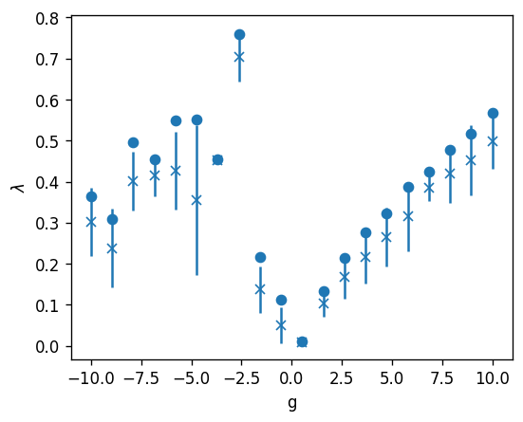
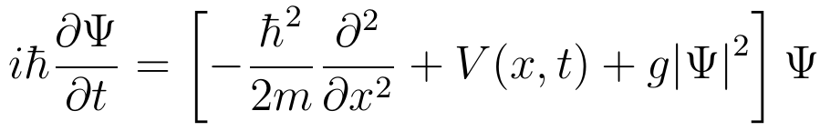
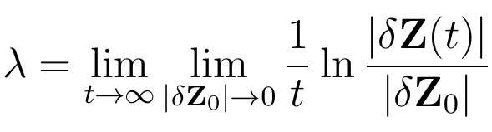
Chaos in Bose-Einstein Condensates
Kevin Evans
Advisor: Dr. Michael Forbes
Washington State University, Department of Physics and Astronomy
Introduction
How does chaos emerge from classical
Classical physics is chaotic but the Schrödinger equation is linear and cannot exhibit chaos
If classical mechanics is chaotic and if quantum mechanics reaches classical mechanics in the classical limit, where does chaos stem from?
Superfluids are well described
What can we learn about chaos from that
HYPOTHESIS
Bose-Einstein Condensates
Bose-Einstein condensates (BECs) are a quantum phenomena where bosons occupy the lowest quantum state
We can realize BECs using superfluid helium-4 (1938) and rubidium-87 (1995)
Chaos TODO
Add Lorenz plots
Chaos is the apparent disorder of a dynamical system
We can characterize chaos using Lyapunov exponents
In a chaotic system, similar initial conditions separate at an exponent rate
The Lyapunov exponent of a system can be described as
Gross-Pitaevskii Equation
The Gross-Pitaevskii equation (GPE) is a nonlinear Schrödinger equation, capable of modeling BECs [approximating]
There is a nonlinear coupling term g which may give rise to chaos
When g = 0, the GPE returns the regular Schrödinger equation and should exhibit no chaos
The GPE is described as
Methods
Simulate the GPE numerically
Evolve two close-by states
Perturbed two excited initial states calculated the Lyapunov exponent
Ensured error was minimized by using optimal discretization spacings and checked time-reverse convergence
Results
For (g=0), Schrödinger equation is not chaotic, as expected, and returns a zero exponent
The GPE exhibits chaos for positive g
There is a linear relationship between the coupling constant g and the Lyapunov exponent
Effect of g on the Lyapunov exponent
For positive g, the relationship appears to be linear between the Lyapunov exponent, indicating a correspondence between the nonlinearity of the GPE and chaos.
Conclusion and Discussion
We confirm our hypothesis, etc.
The GPE has chaotic motion for non-zero g
The nonlinearity of the GPE leads to chaotic dynamics
BECs should exhibit chaos
Additional research is necessary to understand the roots of chaos in BECs
Higher dimensions, systems with quantum turbulence
Irl Experimental measurements?
Is the chaos a failure of the gpe or is it real?
References

